Slide 1
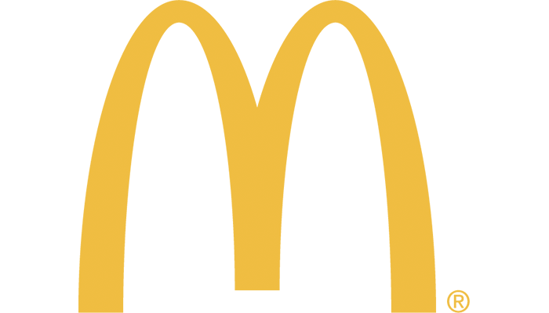
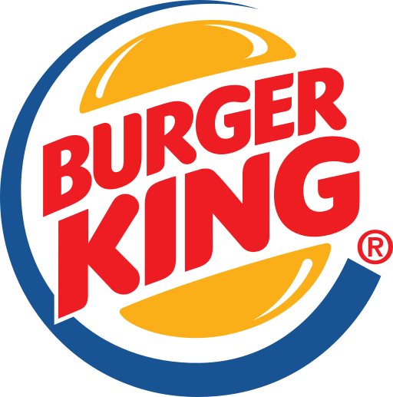

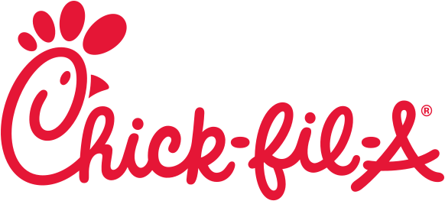
By: James Liem
Final Project: The Big Fast Food Chain War: McDonald's vs. Burger King vs. Chick-fil-A

Slide 2
Business Problem & Approach
I am interested in analyzing the social media of McDonald's, Burger King, and Chick-fil-A. I would like to analyze what people are saying about these 3 fast food companies and what these 3 companies are saying to customers. I will use Twitter as the social media source for my analyses and data collection. Using Twitter API, I am able to collect data from each company’s Twitter and the tweets mentioning them. After I collect data, I will analyze the data using many types of social media analytics such as descriptive, content, sentiment, network analytics and topic modeling (unsupervised machine learning).

Slide 3
Business Problem & Approach
In this project, I am interested in finding the answers from these questions:
What are the promotions offered through each company’s Twitter account?
What is each company mostly talking about from their tweets?
What are people saying about each company in Twitter? How is the review on Twitter?
How is the comparison between the promotions offered by each company?
What are the tweets saying?
Which fast food chain has the most positive reviews?
Which fast food chain has the most negative reviews?
Who are the top people mentioning the company?
How is the network from each company?
What are the popular topics on the reviews of each company?

Slide 4
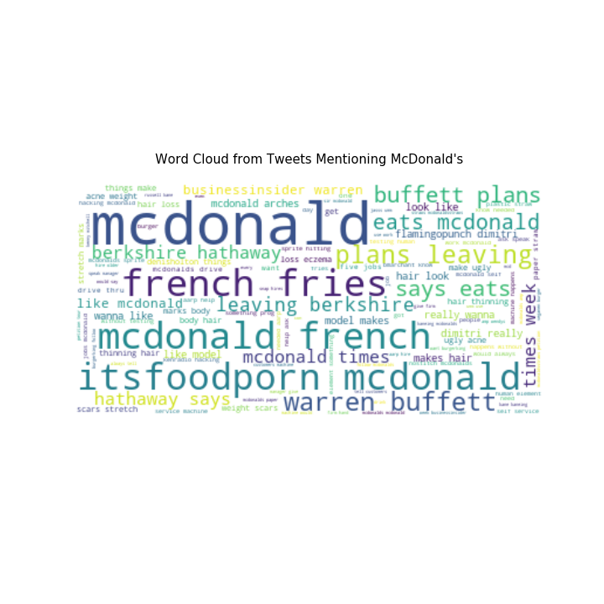
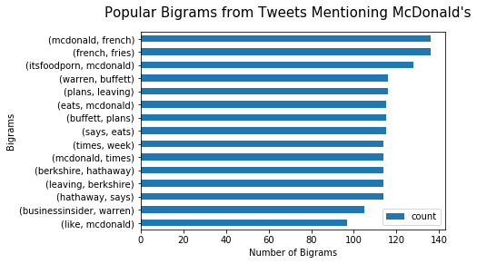
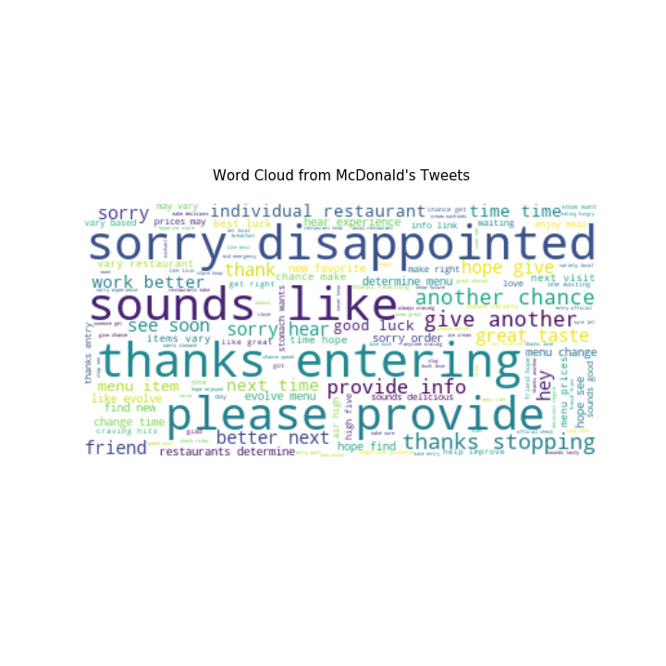
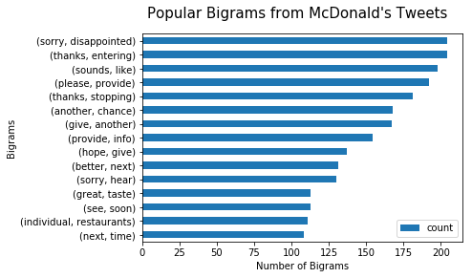
McDonald’s Twitter Analysis Findings / Results
Descriptive and Content Analysis

Slide 5
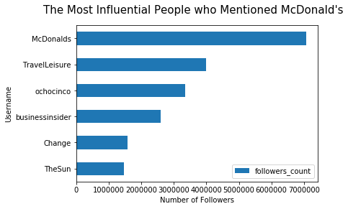
McDonald’s Twitter Analysis Findings / Results
Descriptive and Content Analysis
Notes:
It appears that the most influential username that mentioned McDonald's was a travelling company, which tweeted about international McDonald's items are coming to the US and the sentiment is pretty positive. TravelLeisure also has almost 4 million twitter followers. Fortunately, the most influential person tweeted a positive thing about McDonald's. Otherwise, it could damage McDonald's reputation.

Slide 6
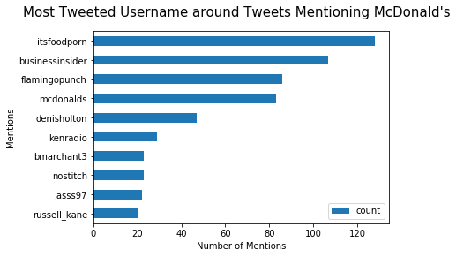
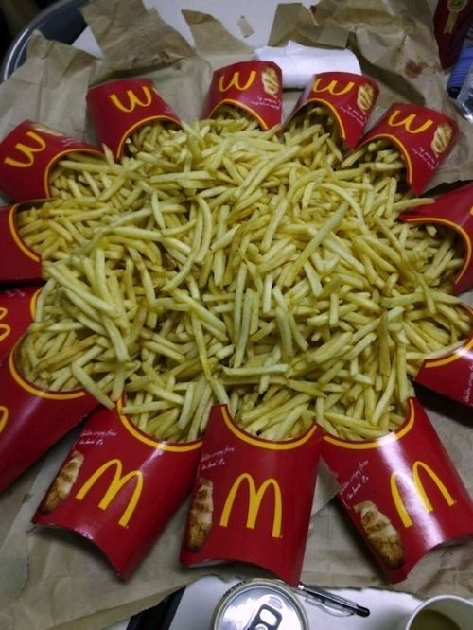
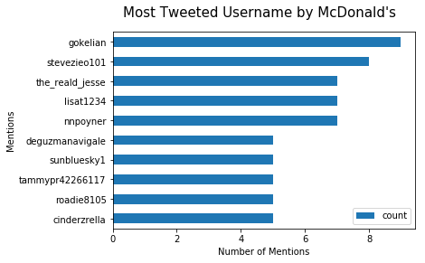
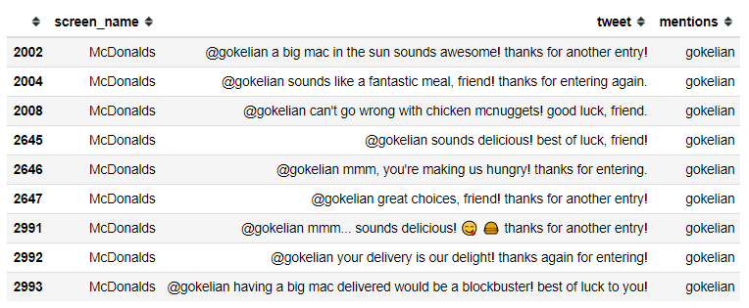
McDonald’s Twitter Analysis Findings / Results
Descriptive and Content Analysis
Notes:
It appears that people have been retweeting one same tweet by itsfoodporn. The tweet appears to be McDonald's French Fries picture. It appears that McDonald's has been replying gokelian's sweepstakes entry back.

Slide 7
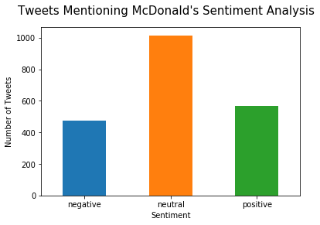
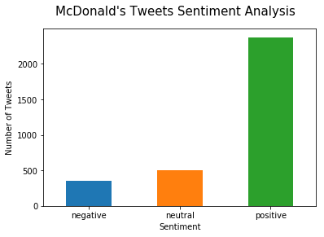
McDonald’s Twitter Analysis Findings / Results
Sentiment Analysis
Notes:
The average sentiment for tweets mentioning McDonald’s : 0.04 negative 475 neutral 1015 positive 566
The average sentiment for McDonald's tweets: 0.44 negative 354 neutral 497 positive 2373

Slide 8
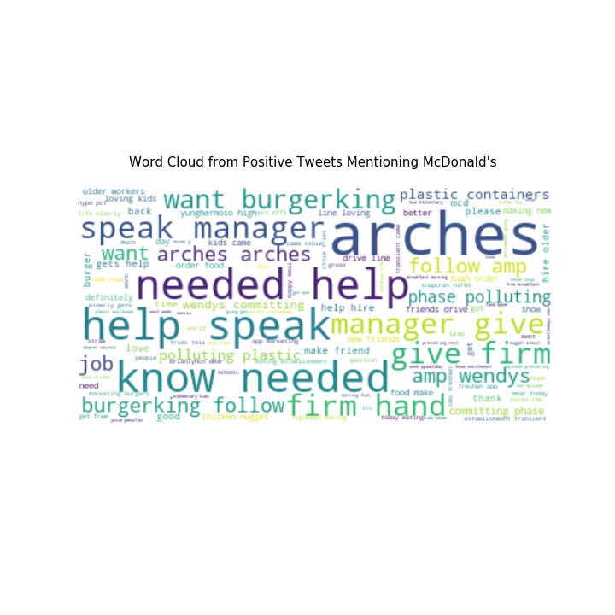
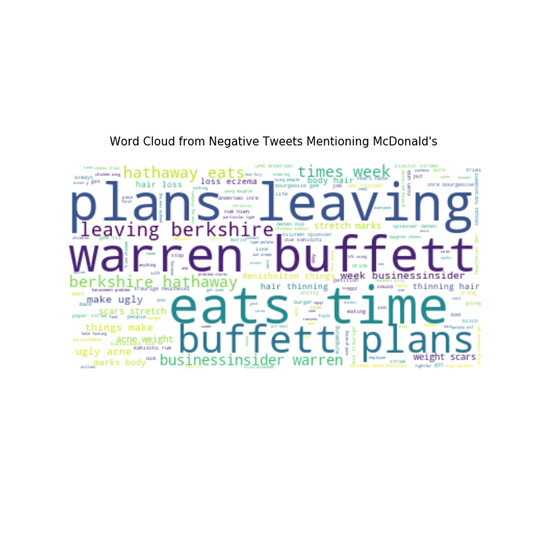
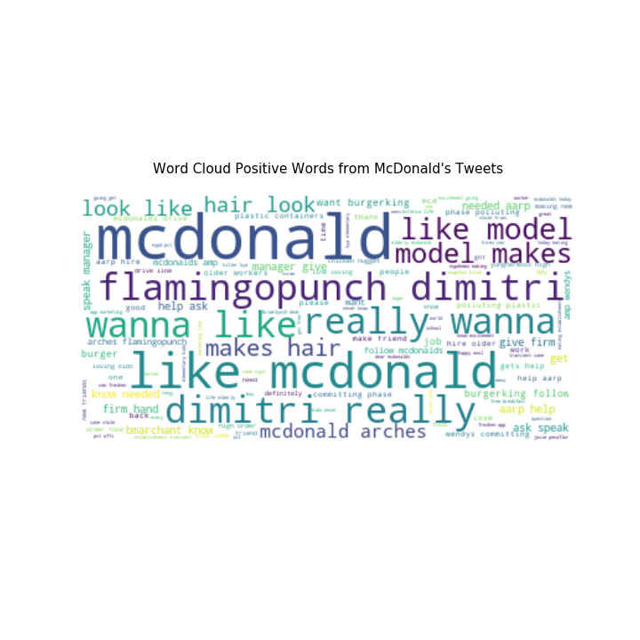
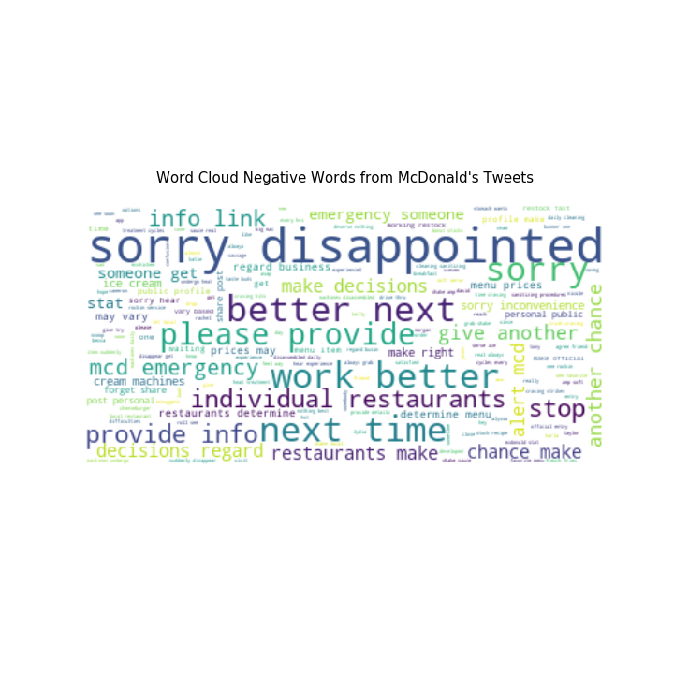
McDonald’s Twitter Analysis Findings / Results
Sentiment Analysis

Slide 9
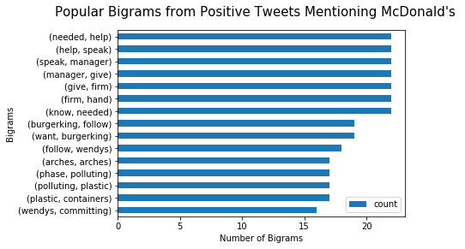
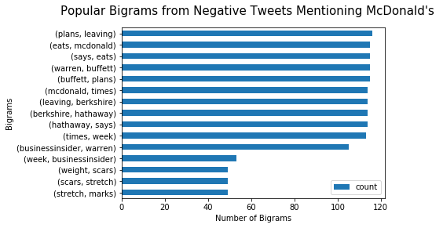
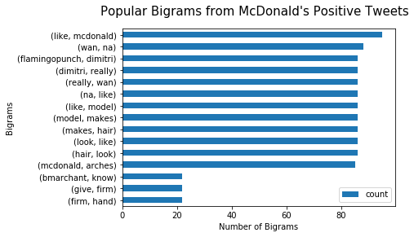
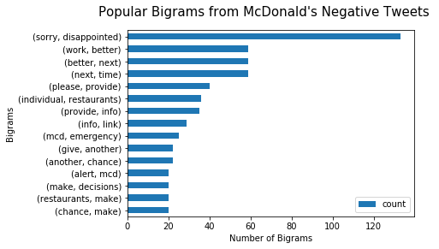
McDonald’s Twitter Analysis Findings / Results
Sentiment Analysis

Slide 10
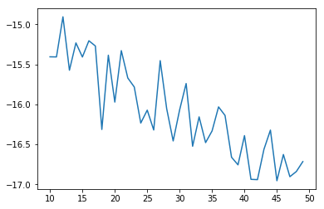
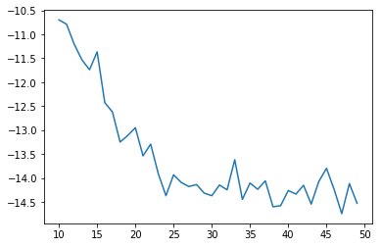
McDonald’s Twitter Analysis Findings / Results
Topic modeling using LDA
Determining optimal k-value
Tweets Mentioning McDonald's
McDonald’s Tweets
Optimal k-value: 12
Optimal k-value: 10

Slide 11
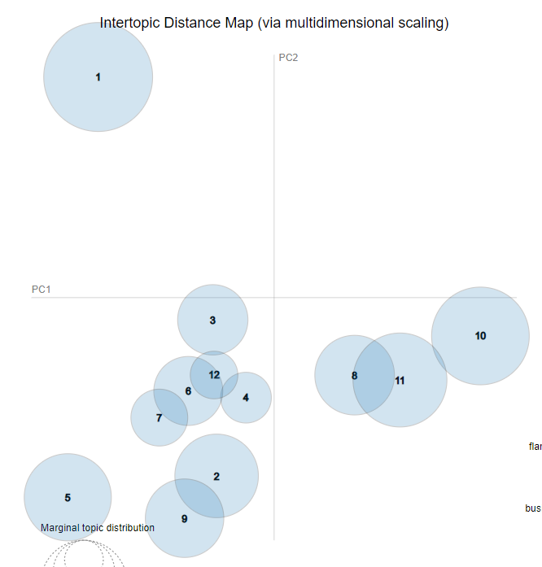
McDonald’s Twitter Analysis Findings / Results
Topic modeling using LDA
Tweets Mentioning McDonald's Topics:
French fries by itsfoodporn and Warren Buffet plans
Real people need to get job
Bring vegan burger menu
Burger King and KFC to watch games
Gaming player samsora pro life
Fried chicken wing
Calling manager and worker to help customer
Drive thru
Get going with breakfast
Flamingopunch and model dimitri hair
Wendy's lunch hair body ugly
Local night sauce
Visualization with Gensim

Slide 12
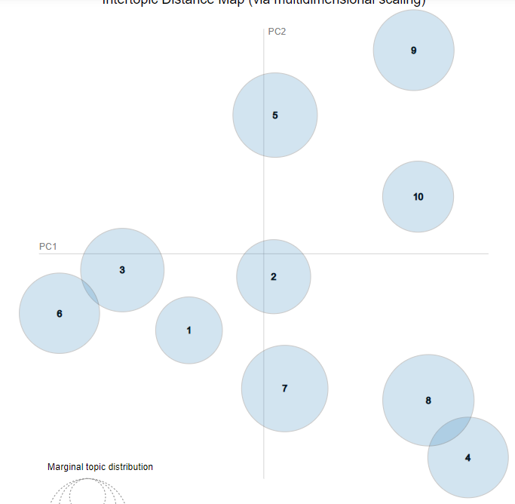
McDonald’s Twitter Analysis Findings / Results
Topic modeling using LDA
Visualization with Gensim
McDonald's Tweets Topics:
Gratitude and thanking to customers
Love someone get craving on the fries
Saying see you again soon and always craving
Sorry for something and asking for more information to help customers
Favorite menu and hoping to see some change on the menu
Thanks for entering the sweepstakes and wishing best of luck
Thanks for entering the entry and sorry for not getting the prize
Making up for mistake and handling complaints for your next visit
Menu on local restaurants vary
To make your sweepstakes entry official, please check the rule

Slide 13
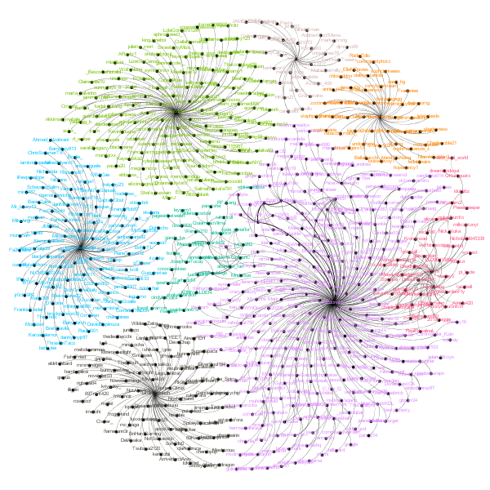
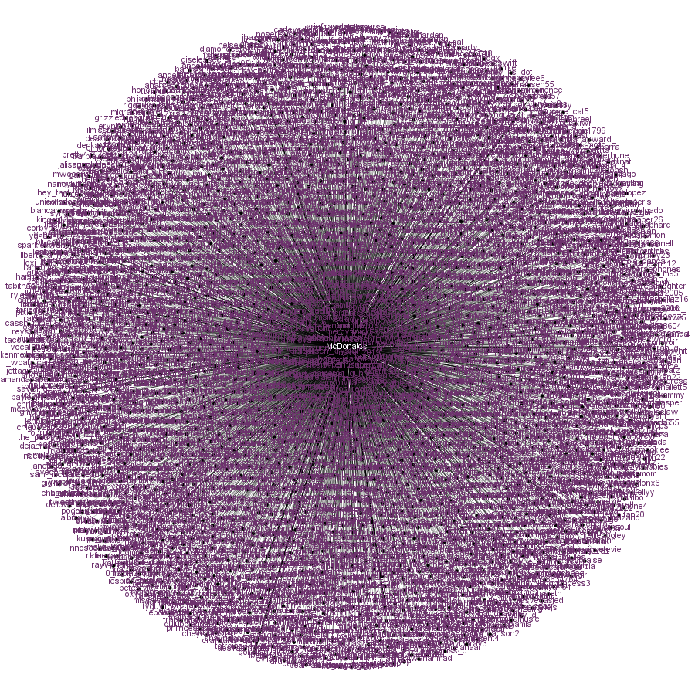
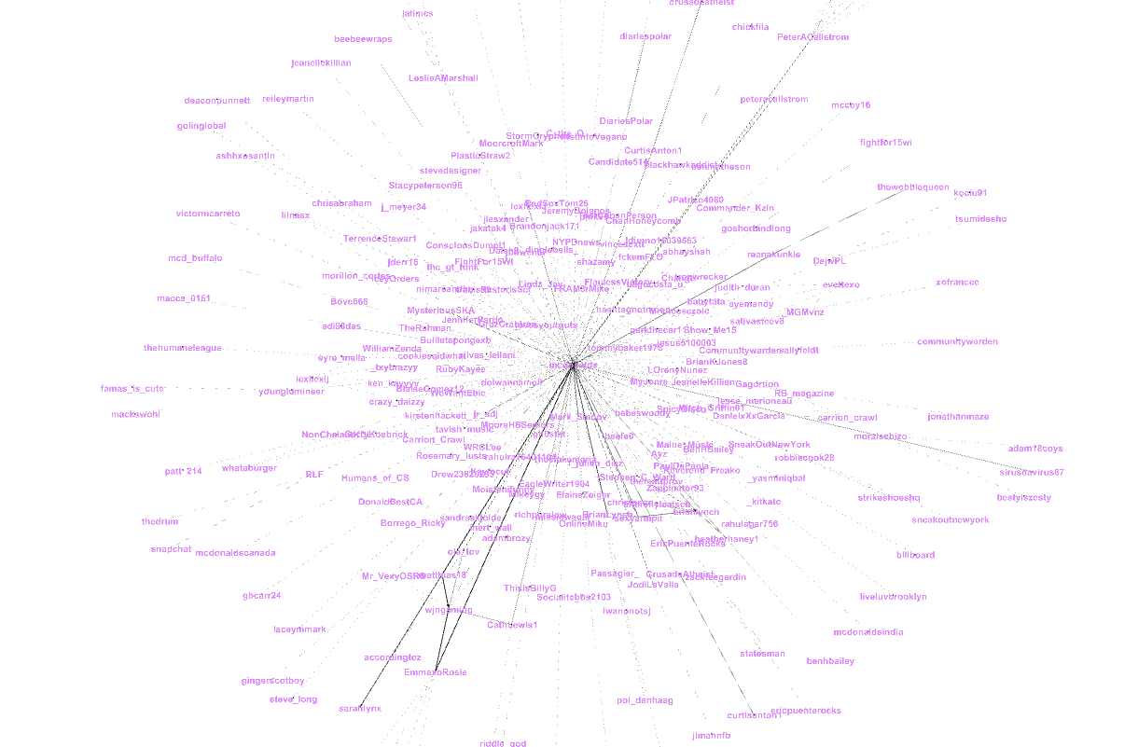
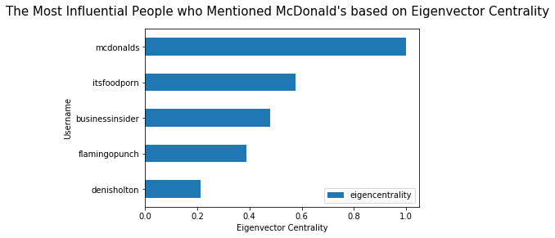
McDonald’s Twitter Analysis Findings / Results
Network Analysis

Slide 14
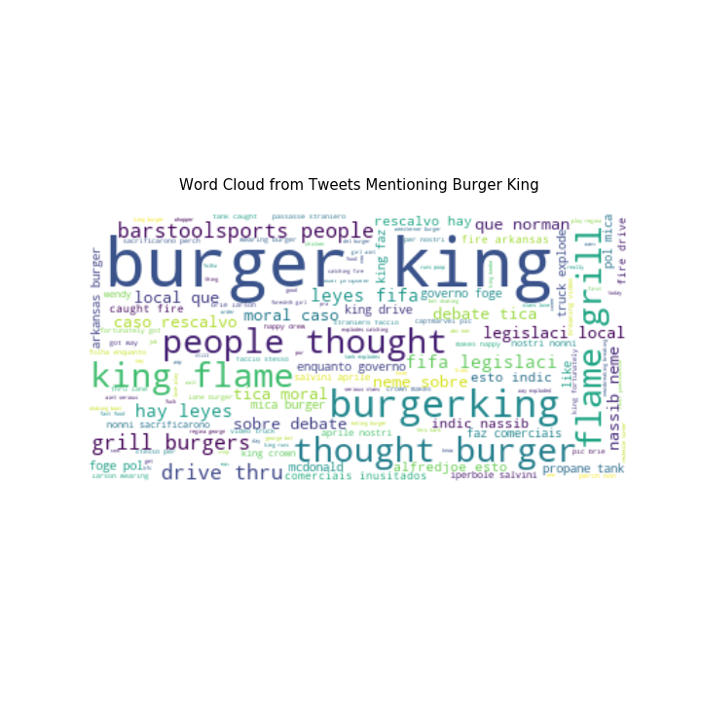
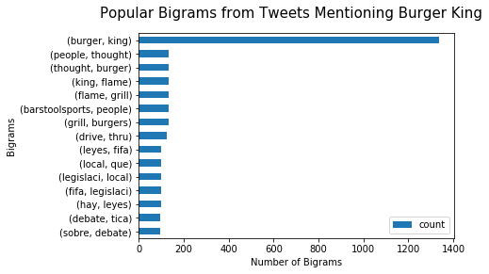
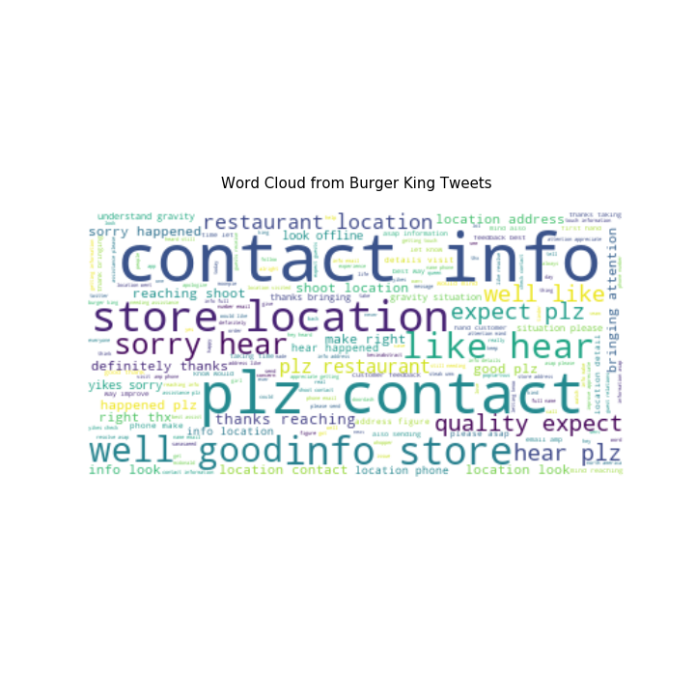
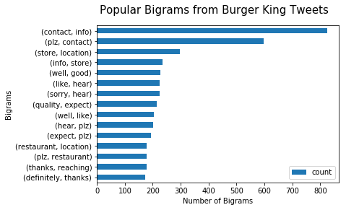
Burger King Twitter Analysis Findings / Results
Descriptive and Content Analysis

Slide 15
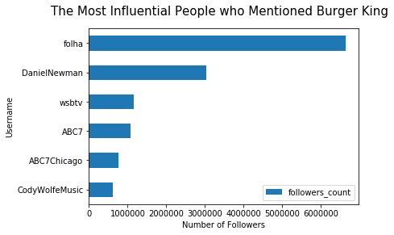
Burger King Twitter Analysis Findings / Results
Descriptive and Content Analysis
Notes:
It appears that the most influential username that mentioned Burger King was a brazillian newspaper company called folha, which tweeted about how Burger King creates unused commercials. Folha is a very influential Twitter user and has more than 6.5 million followers.

Slide 16
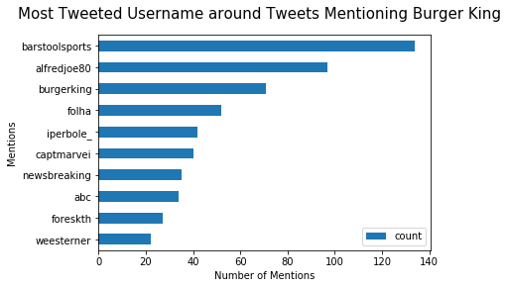
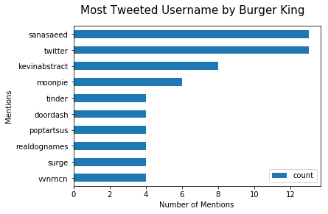
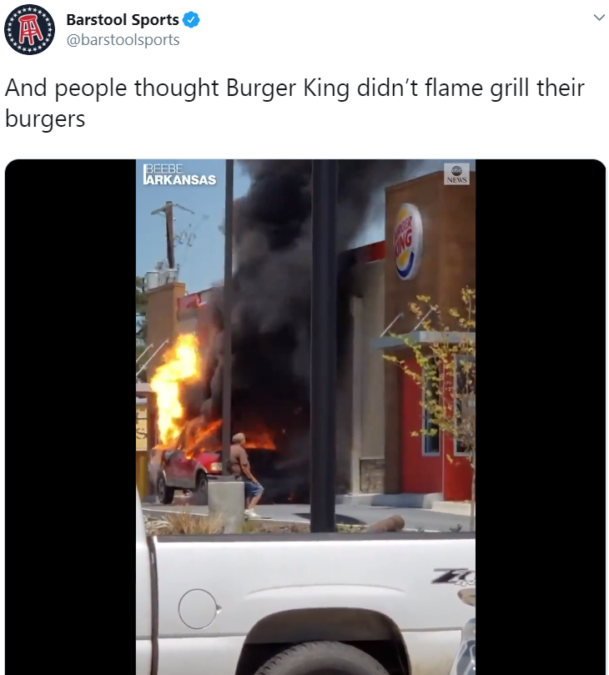
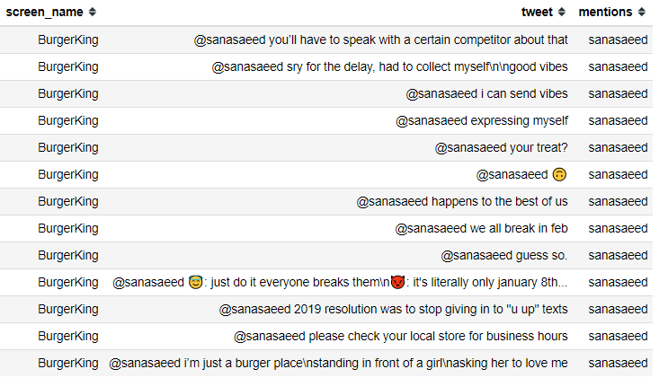
Burger King Twitter Analysis Findings / Results
Descriptive and Content Analysis
Notes:
It appears that people have been retweeting one same tweet by barstoolsports. The tweet appears to be a video with car being burned and exploded in front of a Burger King shop. It appears that Burger King has been replying back to sanasaeed for a few jokes.

Slide 17
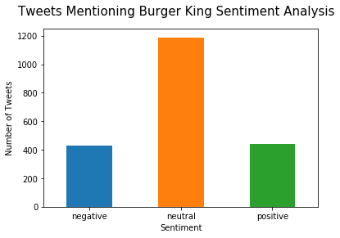
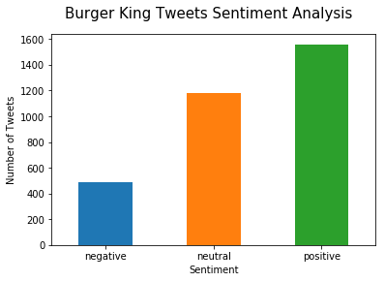
Burger King Twitter Analysis Findings / Results
Sentiment Analysis
Notes:
The average sentiment for Tweets mentioning Burger King: 0.02 negative 432 neutral 1189 positive 440
The average sentiment for Burger King tweets: 0.17 negative 488 neutral 1181 positive 1559

Slide 18
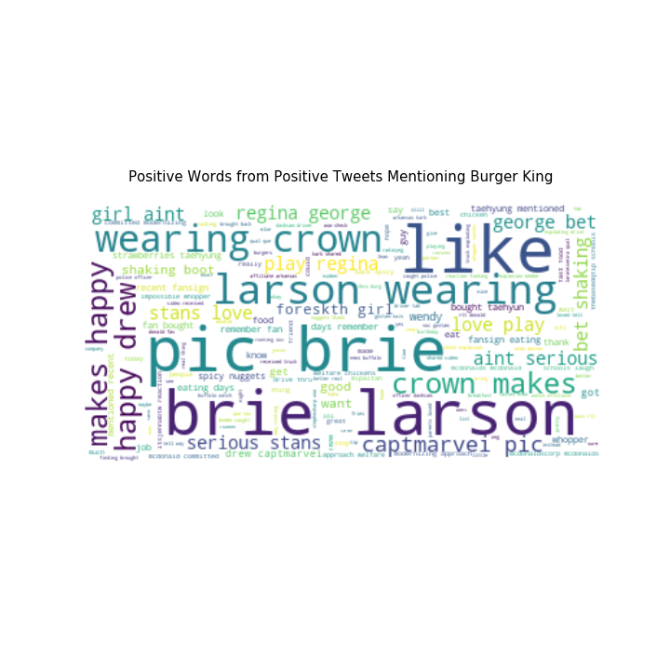
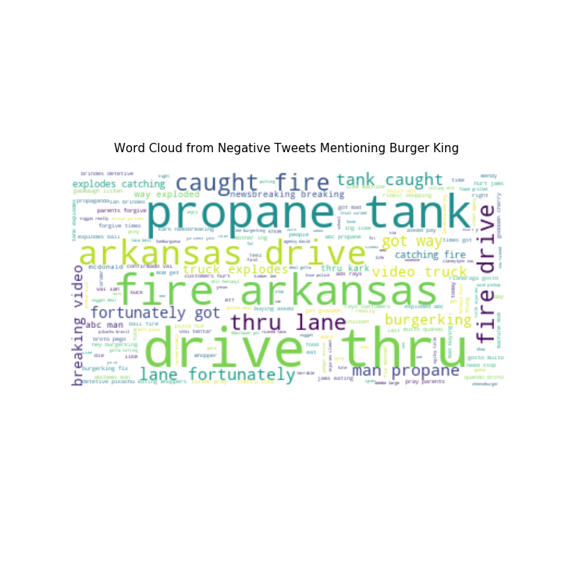
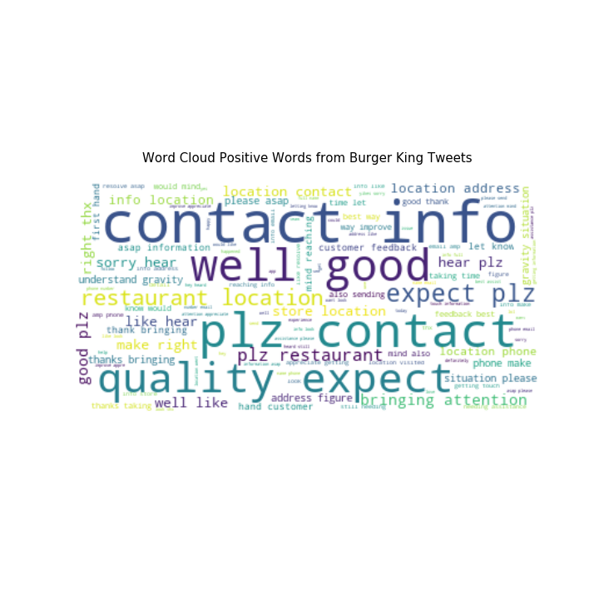
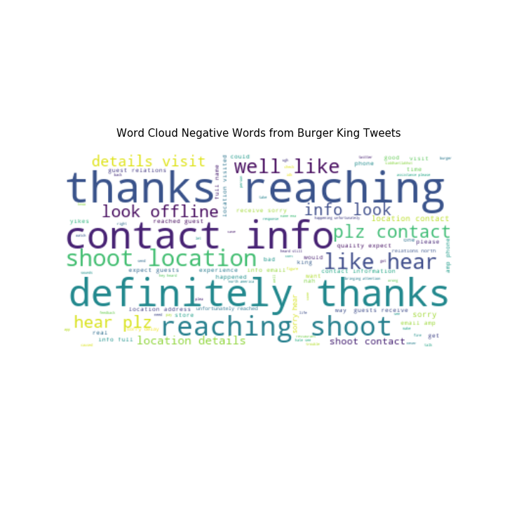
Burger King Twitter Analysis Findings / Results
Sentiment Analysis

Slide 19
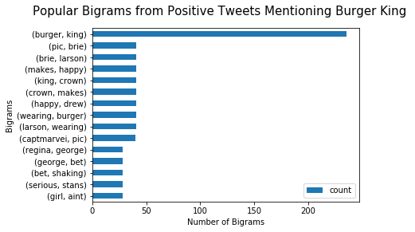
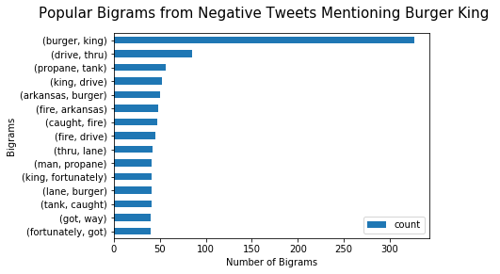
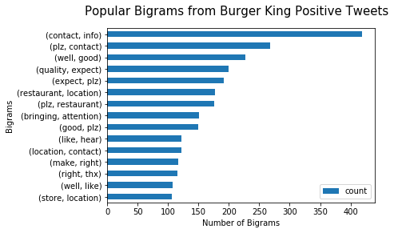
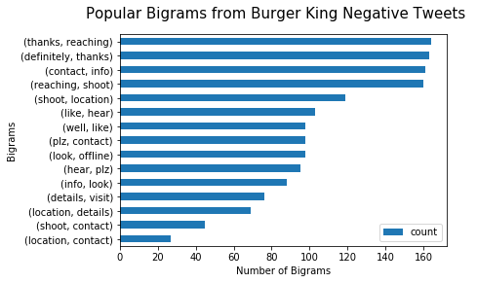
Burger King Twitter Analysis Findings / Results
Sentiment Analysis

Slide 20
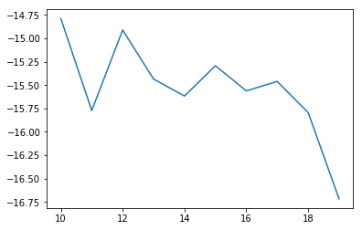

Burger King Twitter Analysis Findings / Results
Topic modeling using LDA
Determining optimal k-value
Tweets Mentioning Burger King
Burger King Tweets
Optimal k-value: 10
Optimal k-value: 11

Slide 21

Burger King Twitter Analysis Findings / Results
Topic modeling using LDA
Tweets Mentioning Burger King Topics:
Burger King timing sucks
Burger King is like McDonald's and Wendy's today
McDonald's and Wendy's mad customers want food
Folha commercials and Arkansas fire car explodes
Burger King mentions in Portuegese community
Sunset in Bali
Brie Larson pictures or Captain Marvel wearing crown
There is fire in the drive thru
Barstoolsports posts
Burger King mentions in Italian community

Slide 22

Burger King Twitter Analysis Findings / Results
Topic modeling using LDA
Burger King Tweets Topics:
Sorry to hear the situation
One day, people could see Kevin Abstract the rapper
Please contact the store location and sorry to hear what happened
Assistance needed in the Burger King store location
Burger King needs to resolve asap in this store location
Expect some quality at this location and please allow us to make it right and contact us
Love whopper and order and management team and experience
Thank you for bringing up the attention to us
Sending thanks
Please contact the information by email

Slide 23




Burger King Twitter Analysis Findings / Results
Network Analysis

Slide 24




Chick-fil-A Twitter Analysis Findings / Results
Descriptive and Content Analysis

Slide 25

Chick-fil-A Twitter Analysis Findings / Results
Descriptive and Content Analysis
Notes:
It appears that the most influential username that mentioned Chick-fil-A was a giant news company, CNN, which tweeted about Chick-fil-A special easter Sunday delivery to help a very sick boy. CNN is a very influential Twitter user and has more than 41 million followers and fortunately, the sentiment of CNN tweet is positive, which is good for Chick-fil-A.

Slide 26


Chick-fil-A Twitter Analysis Findings / Results
Descriptive and Content Analysis
Notes:
There are 12 users that have been most mentioned by Chick-fil-A.

Slide 27


Chick-fil-A Twitter Analysis Findings / Results
Sentiment Analysis
Notes:
The average sentiment for Tweets mentioning Chick-fil-A : 0.09 negative 446 neutral 744 positive 848
The average sentiment for Chick fil a tweets: 0.36 negative 319 neutral 591 positive 2326

Slide 28




Chick-fil-A Twitter Analysis Findings / Results
Sentiment Analysis

Slide 29




Chick-fil-A Twitter Analysis Findings / Results
Sentiment Analysis

Slide 30


Chick-fil-A Twitter Analysis Findings / Results
Topic modeling using LDA
Determining optimal k-value
Tweets Mentioning Chick-fil-A
Chick-fil-A Tweets
Optimal k-value: 10
Optimal k-value: 10

Slide 31

Chick-fil-A Twitter Analysis Findings / Results
Topic modeling using LDA
Tweets Mentioning Chick-fil-A Topics:
Special Sunday delivery to a very sick boy
Best chicken nugget Georgia-based
First discovered near ruin in Jerusalem
Watching and eating Chick-fil-A
Polynesian mom try Chick-fil-A sauce
A man orders Chick-fil-A
Every morning drinks at Chick-fil-A
San Antonio airport banned bible
Best service and best sauce and milkshake
Drive fry Chick-fil-A

Slide 32

Chick-fil-A Twitter Analysis Findings / Results
Topic modeling using LDA
Chick-fil-A Tweets Topics:
Appreciating customers visits
Spicy nuggets seem interesting
Love testing new spicy item that could be different
Chick-fil-A is always reaching local and great
Apologizing to customers and directing them to contact by call
Membership app
Thanking fan, member, server, and team
Hearing customer's voice by appreciating and apologizing for mistakes
Appreciating customer's feedback and make up for them
Appreciating for feedbacks and sharing chicken

Slide 33




Chick-fil-A Twitter Analysis Findings / Results
Network Analysis

Slide 34
Conclusion/Summary/Storytelling
From more or less than 3000 tweets, each company barely does promotion in their tweets. Mostly, they just respond to customer’s feedbacks and directs them to their hotline number or email. However, only McDonald’s did some kind of sweepstakes and they responded to their customer’s entry in Twitter.
People like to talk about the French fries of McDonald’s, the video of an explosion of a truck on Burger King’s drive thru, and Chick-fil-A’s Sunday delivery to a sick boy.
Chick-fil-A has the most positive tweets from people’s tweets and the company’s own tweets. McDonald’s and Burger King mostly have neutral sentiment on their tweets and from people’s tweets.
The most influential people who mentioned these 3 companies are all media organizations. These organizations have the most followers among all people who mentioned these companies. News and media company mentioned Chick-fil-A and Burger King while a travel magazine company mentioned McDonald’s.
For Burger King, there are so many Brazilian people who mentioned and talked about Burger King. Perhaps, it was also mentioned by the most influential person, Folha which is a newspaper company based in Sao Paulo.

Slide 35
Conclusion/Summary/Storytelling
For positive reviews, many people love Chick-fil-A’s chicken nuggets. Many people also talked about Captain Marvel and Brie Larson mentioning Burger King. As for McDonald’s, people like about the company’s arches.
For negative reviews, many people talked about Warren Buffet’s plans leaving McDonald’s. Many people also talked about a truck exploding on Burger King’s drive thru in Arkansas. People also mentioned San Antonio airport banning Chick-fil-A.
It is interesting sometimes to see how people talked a lot about weird things related to each company. But, it is also good to know what is going on Twitter and what people are talking about.
Sometimes, it is also helpful to see what irritates people or what makes people like things from each company.
For network analysis, the tweets mentioning each company are divided into 8 clusters using Gephi. All 3 companies have 8 different clusters, where the biggest cluster is centered on each company.

Slide 36
Sources
https://news.mcdonalds.com/press/multimedia-library/logos
https://commons.wikimedia.org/wiki/File:Burger_King_Logo.svg
https://en.wikipedia.org/wiki/File:Chick-fil-A_Logo.svg

